Slide 1
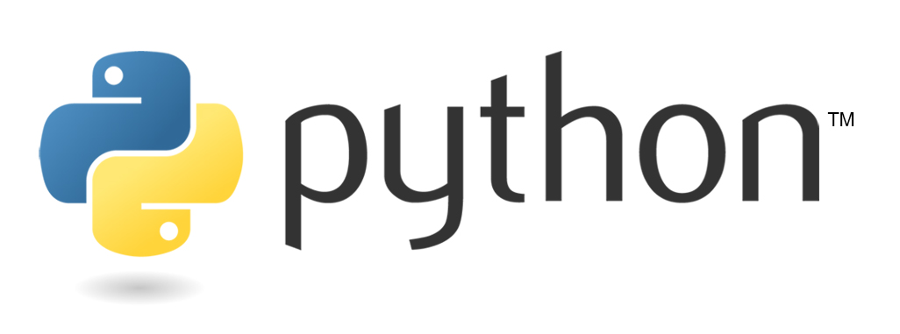

Bootcamp
Session 5
alphacloudone.com

Slide 2
Class Object
Another object in Python is the Class object.
The use of classes allows programmers to create their own objects that have custom methods and common attributes.
Similar to how other types of objects, such as lists and dictionaries have built-in methods, our Class objects can have their own custom built-in methods
In large programs, Classes give us the opportunity to maintain and use objects repeatedly

Slide 3
Class Object
Let’s start with a conceptual view of what a Class Object might look like
For this example, our Class is going to be an Automobile
For this class, we will define three attributes
Engine
Doors
tires

Slide 4
Class Object
Let’s create an instance of this Class
We’ll call it HondaAccord
And we’ll set the following attributes
Engine- v6
Doors- 4
Tires- Goodyear
Now I can pass around this object, and retrieve it’s attributes at any time

Slide 5
Class Object
Let’s create another instance of this Class
We’ll call it ChevySiverado
And we’ll set the following attributes
Engine- v8
Doors- 2
Tires- Continental
Now I can pass around this object, with it’s specific attributes

Slide 6
Class Object
Now that we have our new class called Automobile, we can create some custom methods for it
For example, we could have one called change_oil, that checks on the specs for the object and determines which type of oil it needs
Or one that is called sell_car, that passes ownership of the object.
These are conceptual views of what we can do with Classes, but you would approach coding a new class object in the same way.
Figure out what you want to do with your new class, what attributes it will hold, and the functions you want to perform on it/with it before you start coding.

Slide 7
Coding a new Class Object
class NewClassName():
def __init__(self, parameter1, parameter2)
self.param1 = parameter1
self.param2 = parameter2
def new_method_name(self):

Slide 8
Name of the Class- you will call this whenever creating a new class object. Use camel case.
Coding a new Class
class NewClassName():
def __init__(self, parameter1, parameter2)
self.param1 = parameter1
self.param2 = parameter2
def new_method_name(self, input1, input2):
Required function- this defines the structure of the class object, including it’s parameters
Custom methods you create. Must always include ‘self’ in method definitions.

Slide 9
User Input
In Python, we can prompt for user input
input_text = input(“Pease type in some text”)
The user input is then saved as our variable input_text

Slide 10
User Input
Input is always text
Can check for proper response, and loop until the expected input is received
Can use the int method to convert a string number to int
“8” to int 8
int(input_variable)

Slide 11
User Input
When you run the input method, it waits for the input
Wont proceed until the user responds
If you run the cell twice, it will get stuck

Slide 12
User Input
Validation Loop
Valid_input = False
while valid_input == False
Choice = input(“enter input”)
If choice != ‘Y’ or choice != ‘N’
Print(“that is not valid, try again”)
else
valid_input = True

Slide 13
Scope
Set of rules that determines visibility of your variable in other areas of your code
LEGB
Local- assigned in a function or lambda
Enclosing function locals- names in the local scope of any and all enclosing functions from inner to outer
Global- assigned at the top-evel of a module file, or declared global
Built-in – Names preassigned in the built-in names module- list, open, range, etc

Slide 14
Scope
Python checks in order
Local
Enclosed local
Global
Variables assigned globally are accessible anywhere
Variables assigned in a function, accessible inside nested functions
Variables assigned in a function aren’t accessible outside of the function
Don’t assign Global variables in functions
Be careful not to overwrite built-in names

